Slide 1
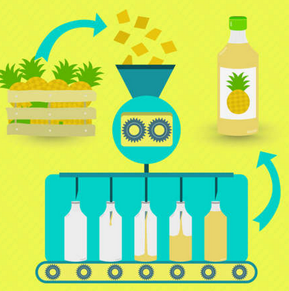
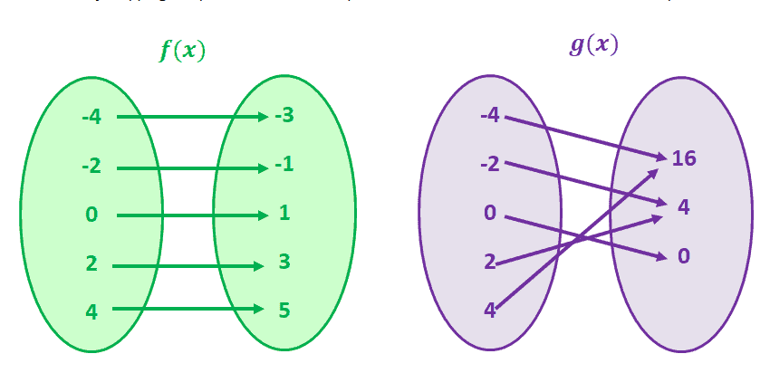
Functions
Sumaiyah Zahid

Slide 2
https://www.hackerrank.com

Slide 3
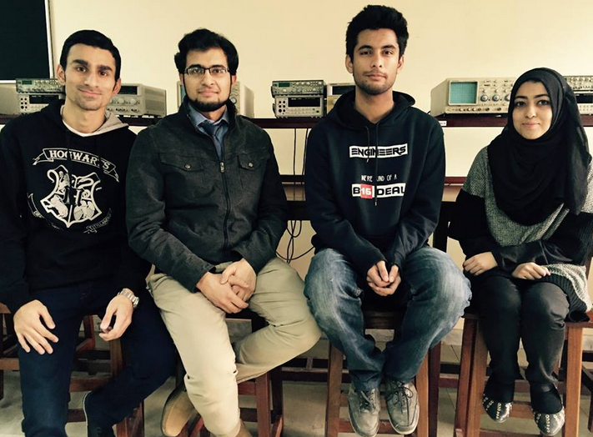


Function Definition
A function is a black box which relates input to output.
INPUT MYSTERY OUTPUT
Outer World don’t know what happens inside.
Your relatives think it’s fun but in actual it isn’t.

Slide 4
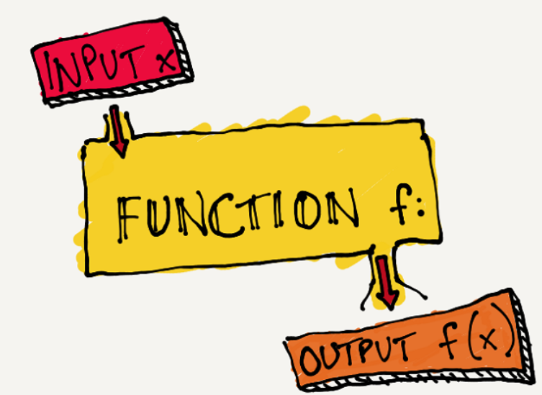
Function
Output Function_Name ( Input )
int main(void) //void = input
{
return 0; // Output
}
Function name = main
Output datatype = int

Slide 5
Input / Arguments / Parameters
printf(“Hello World”);
scanf (“%d”, &a);
printf and scanf are functions.
Inputs are separated by commas.
Inputs are also known as arguments or parameters.

Slide 6
Output / Return Values
a=printf(“Hello World”);
b=scanf (“%d”, &a);
printf(“%d %d”, a,b); // Try this
printf returns an integer value, which is the total number of printed characters.
scanf returns an integer value, which is the total number of inputs.

Slide 7
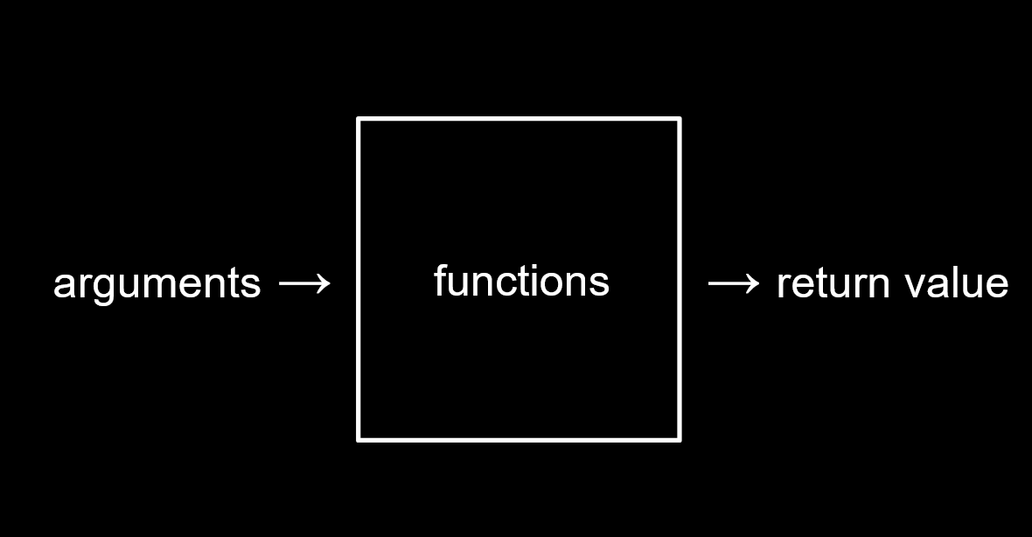
Function Definition
A block of code that performs a specific task.
They avoid duplicating codes.
Function help you break down a big project.
Library Functions
User - Defined Functions

Slide 8
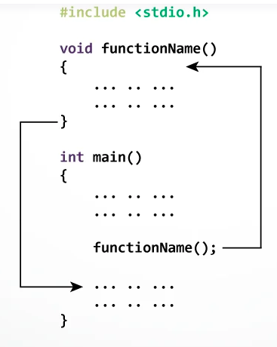
User - Defined Functions
ReturnType FunctionName (Arguments);
int add (int a, int b)
3 important things:
Function declaration or prototype
Function call
Function definition

Slide 9
#include <stdio.h>
void smile(); // Function Declaration or Prototype
int main()
{
smile(); // Function Call
return 0;
}
void smile() // Function Definition
{
printf("\nSmile, and the world smiles with you...");
}

Slide 10
#include <stdio.h>
void smile() // Function Declaration & Definition
{
printf("\nSmile, and the world smiles with you...");
}
int main()
{
smile(); // Function Call
return 0;
}

Slide 11
Practice QUestion
Make a function in C which prints following pattern.
****
****
****
****

Slide 12
#include <stdio.h>
void star(); // Function Declaration or Prototype
int main()
{
star(); // Function Call
return 0;
}
void star() // Function Definition
{
int i;
for(i=0; i<4; i++)
printf("\n****");
}

Slide 13
#include <stdio.h>
void add(int a, int b); // Function Prototype
int main()
{
add(5,4); // Function Call
return 0;
}
void add(int a, int b) // Function Definition
{
printf("%d", a+b);
}

Slide 14
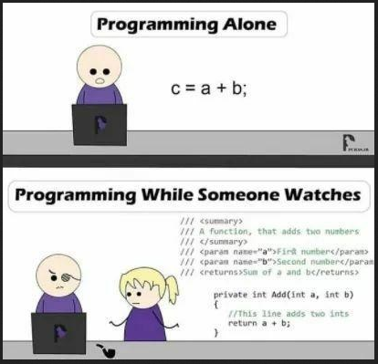
#include <stdio.h>
int add(int a, int b);
int main()
{
int sum;
sum=add(5,4);
printf("%d", sum); // you can’t access a and b here
return 0;
}
int add(int a, int b)
{
int c=a+b; // you can’t access sum here
return c;
}

Slide 15
Why Functions?
To hide irrelevant detail at the main() level, so the the program's primary purpose is clearer.
To divide a complex problem into a series of simple problems
To make subsequent modification of the program easier.
To reduce the errors that inevitably come with a single large complex program

Slide 16
Practice QUestion
Make a function in C which takes one int argument and check whether it’s an even or odd.

Slide 17
#include <stdio.h>
int even_odd(int x);
int main()
{
int num=6;
even_odd(num);
return 0;
}
int even_odd(int x)
{
if (x%2==0)
printf(“It’s an even number!”);
else
printf(“It’s an odd number!”);
}

Slide 18
Practice QUestion
Make a function in C which takes int as a parameter and return it’s cube value.

Slide 19
#include <stdio.h>
int cube(int a);
int main()
{
int num=4, result;
result=cube(num);
printf("%d", result);
return 0;
}
int cube(int a)
{
return a*a*a;
}

Slide 20
Passing Array Elements
Passing array elements to a function is similar to passing variables to a function.
void display(int age1, int age2) {
}
int main() {
int ageArray[] = {2, 8, 4, 12};
display(ageArray[1], ageArray[2]);
return 0;
}

Slide 21
Passing Array
1D array:
void myFunction(int arr[10]);
void myFunction(int arr[]);
2D array:
void myFunction(int arr[10][10]);
void myFunction(int arr[][10]);

Slide 22
#include <stdio.h>
float calculate_sum(float arr[]) ;
int main()
{
float array[5]={1.5, 2.3,4.5,6.7,1.3};
printf("%f", calculate_sum(array));
return 0;
}
float calculate_sum(float arr[])
{
float sum=0; int i;
for(i=0; i<5; i++)
sum=sum+arr[i];
return sum;
}

Slide 23
#include <stdio.h>
float calculate_sum(float arr[], int size) ;
int main()
{
float array[5]={1.5, 2.3,4.5,6.7,1.3};
printf("%f", calculate_sum(array,5));
return 0;
}
float calculate_sum(float arr[], int size)
{
float sum=0; int i;
for(i=0; i<size; i++)
sum=sum+arr[i];
return sum;
}

Slide 24
#include <stdio.h>
float calculate_sum(float arr[2][5]) ;
int main()
{
float array[2][5]={{1.5, 2.3,4.5,6.7,1.3},
{10.3,6.5,3.9,6.7,8.3}};
printf("%f", calculate_sum(array));
return 0;
}
float calculate_sum(float arr[2][5])
{
float sum=0; int i,j;
for(i=0; i<2; i++)
for (j=0; j<5; j++)
sum=sum+arr[i][j];
return sum;
}

Slide 25
Home Assignment
Convert all your Lab 6, 7 and 8 tasks into Functions.

Slide 26
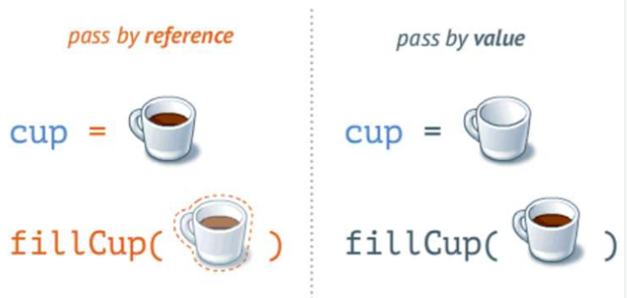
Calling Functions
Call by value
Copy of argument passed to function
Changes in function do not effect original
Use when function does not need to modify argument
Avoids accidental changes
All the examples mentioned before are using call by value.
Call by reference
Passes original argument
Changes in function effect original
Only used with trusted functions

Slide 27
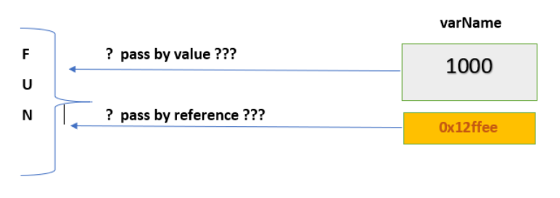
Pass By Reference
void function( int *p);
int *p,num=6;
p = &num;
function( p );

Slide 28
#include <stdio.h>
int cube(int *a);
int main()
{
int num=4, *p;
p=&num;
cube(p); // cube(&num);
printf("%d", num);
return 0;
}
int cube(int *a) // a is an alias or nickname of p
{
*a= (*a) * (*a) *(*a);
}

Slide 29
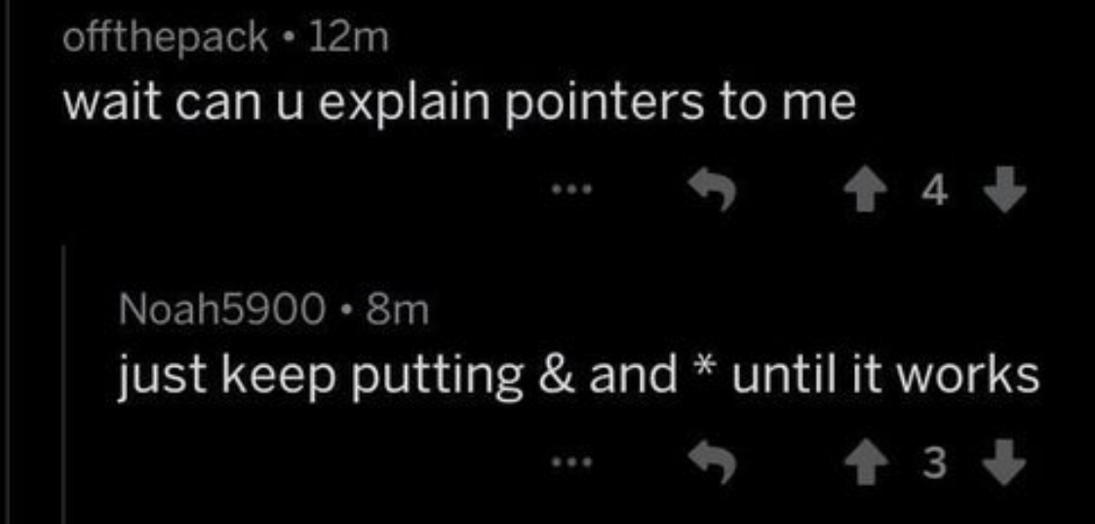
Passing Arrays By Reference
Array name is already a pointer, so passing an array name is itself passing by reference.
That means, if you update array element in function, it also changes in main.

Slide 30
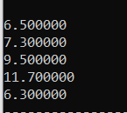
#include <stdio.h>
float array_add(float arr[], int size) ;
int main()
{
float array[5]={1.5, 2.3,4.5,6.7,1.3};
array_add(array, 5);
int i;
for(i=0; i<5; i++)
printf("%f", array[i]);
return 0;
}
float array_add(float arr[], int size)
{
int i;
for(i=0; i<size; i++)
arr[i]=arr[i]+5;
}

Slide 31
#include <stdio.h>
float array_add(float *p, int size) ;
int main()
{
float array[5]={1.5, 2.3,4.5,6.7,1.3};
array_add(array, 5);
int i;
for(i=0; i<5; i++)
printf("%f", array[i]);
return 0;
}
float array_add(float *p, int size)
{
int i;
for(i=0; i<size; i++)
p[i]=p[i]+5; // *p=*p+5; p++;
}

Slide 32

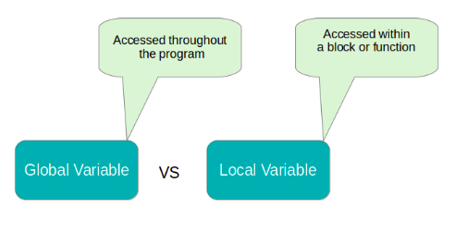
Local Vs Global Variables

Slide 33
#include <stdio.h>
int global=20;
void smile();
int main()
{ i
printf("Local Value is %d\n", local);
printf("Global Value is %d\n", global);
smile();
printf("Global Value is %d\n", global);
return 0;
}
void smile()
{ global+=20;
printf("\nSmile, and the world smiles with you...");}

Slide 34
Nested Functions Calling
We can call another user-defined function inside any user-defined function.
Make a function add which takes two argument and decides whether it’s sum is even or odd.

Slide 35
#include <stdio.h>
int add(int a, int b);
void even_odd(int x);
int main()
{
int sum;
sum=add(5,4);
printf("%d", sum);
return 0;
}

Slide 36
int add(int a, int b)
{
int c=a+b;
even_odd(c);
return c;
}
void even_odd(int x)
{
if (x%2==0)
printf(“It’s an even number!”);
else
printf(“It’s an odd number!”);
}

Slide 37
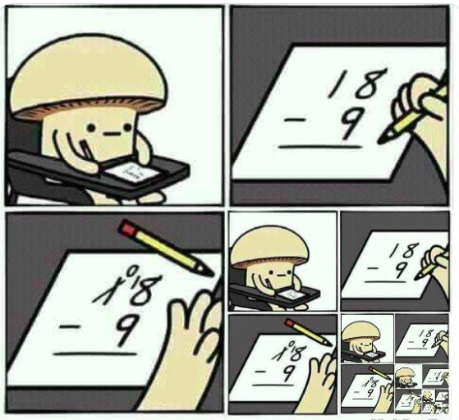
RECURSION
See recursion

Slide 38
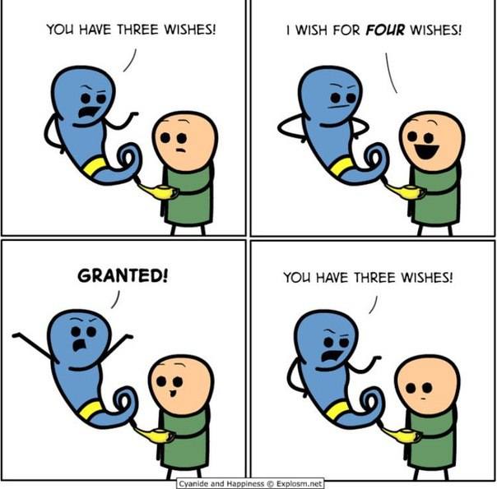
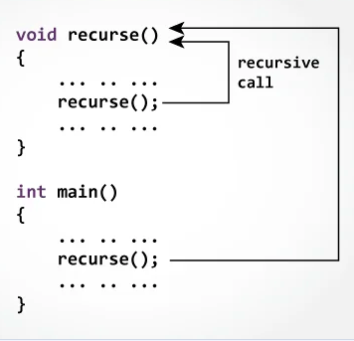
RECURSION
A function calling itself.

Slide 39
RECURSION
fact(n) : n!
fact(1)=1
fact(2)=2*1
fact(3)=3*2*1
fact(4)=4*3*2*1
fact(5)=5*4*3*2*1

Slide 40
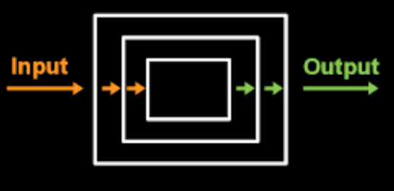
RECURSION
fact(n) : n!
fact(1)=1
fact(2)=2*fact(1)
fact(3)=3*fact(2)
fact(4)=4*fact(3)
fact(5)=5*fact(4)

Slide 41
RECURSION
fact(n) : n * fact(n-1)
Recursive function have 2 cases:
Base Case
Recursive Case

Slide 42
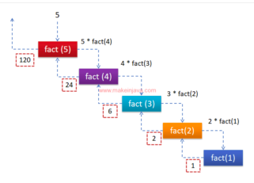
RECURSION
fact(n) : n!
fact(1)=1
fact(2)=2*fact(1)
fact(3)=3*fact(2)
fact(4)=4*fact(3)
fact(5)=5*fact(4)

Slide 43
Factorial Function
int factorial( int n)
{
if (n==1) // Base case
return 1;
else // Recursive Case
return n * factorial(n-1);
}

Slide 44
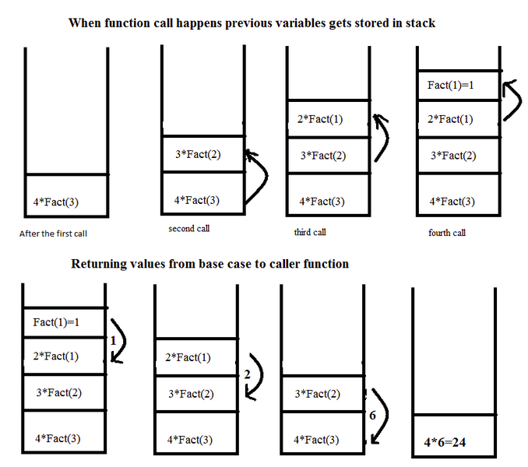

Slide 45
PRActice Question
Write a program in C to calculate the sum of numbers from 1 to n using recursion.

Slide 46
Sum Function
int sum( int n)
{
if (n==1) // Base case
return 1;
else // Recursive Case
return n + sum(n-1);
}

Slide 47
PRActice Question
Write a program in C to print Fibonacci sequence to n terms using recursion.

Slide 48
Fibonacci Function
int fibonacci( int n)
{
if (n==0) // 1st Base case
return 0;
else if (n==1) // 2nd Base case
return 1;
else // Recursive Case
return fibonacci(n-2) + fibonacci(n-1);
}

Slide 49
Home Assignment
Write a program in C to print first 50 natural numbers using recursion.
Write a program in C to print the array elements using recursion.
Write a program in C to count the digits of a given number using recursion.

